Slide 1

SoftEng 751
Canny Edge Detection
Optimisation with cuTile on NVIDIA GPUs
Team 5
Grace Liu Xudong Ma Shiying Yang
May 15, 2026
Notes:
Hello everyone. We are Group 5, and our project is Canny Edge Detection: Optimisation with cuTile on NVIDIA GPUs.
The aim of this project is to implement a Canny edge detection pipeline and accelerate suitable parts using GPU-based execution.

Slide 2

Presentation Overview
Grace Liu
01.
Grace — Algorithm & GPU Parallelisation Model
Canny five-stage pipeline, data parallelism, dependency analysis, scheduling idea
02.
Xudong — Implementation & Optimisation
CPU baseline → CuPy GPU → cuTile-style kernels, tile size sweep, memory transfer minimisation, hybrid GPU/CPU pipeline
03.
Shiying — Performance, Video Stream & Conclusion
Tile size, Benchmark results, pipeline-parallel video, challenges and future work
Notes:
Here is our presentation structure.
First, I will cover the Algorithm and GPU Parallelisation Model, including the Canny pipeline and why it fits parallel computing.
Then, Xudong will explain the Implementation and Optimisation.
Finally, Shiying will present the Performance, Video Stream and Conclusion.

Slide 3






Canny Edge Detection
Grace Liu
Pipeline outputs from our implementation
Input：
Sobel output:
M = sqrt(Gx² + Gy²), θ = atan2(Gy, Gx)
Strong: NMS ≥ high
Weak: low ≤ NMS < high
Iblur = (I * gx) * gy
1.Gaussian Blur
2.Sobel Gradient
3.Non-Max Suppression
4.Double Threshold
5.Hysteresis
Noise reduction
σ = 1.4, k = 5
Magnitude &
angle per pixel
Thin edges to
1-pixel width
Strong / weak
edge classification
Connect weak
edges to strong
Blur
Sobel
NMS
Final edges (threshold + hysteresis)
Notes:
Lets first look at Canny edge detection. It has five main stages.
First, Gaussian blur reduces noise before detecting edges. In our example, we use kernel size 5 and sigma 1.4. The formula shows separable Gaussian filtering: we blur horizontally first and then vertically, which is more efficient than applying a full 2D filter.
Second, Sobel gradient calculates the gradient magnitude and angle for each pixel. Magnitude gives edge strength, and angle gives edge direction.
After that, we use Non-Maximum Suppression, or NMS. After Sobel, edges can still be thick, so NMS keeps only the local maximum pixels along the gradient direction. This makes the edges thinner.
Fourth, Double Thresholding classifies pixels into strong, weak, and non-edge pixels.
Finally, Hysteresis/ˌhɪstəˈrisɪs/ keeps weak edges only if they are connected to strong edges.

Slide 4
Grace Liu
Why Canny Fits Data-Parallel Execution？
Key idea: pixel-level data parallelism
• Image processing applies similar operations to thousands of pixels.
• Gaussian blur and Sobel are stencil-style computations: each output pixel reads
nearby input pixels, but output pixels do not depend on each other.
• NMS is also local, but includes branching based on gradient direction.
• Thresholding is pixel-wise; hysteresis is harder because it depends on edge connectivity.
• For video, the same pipeline must run for every frame, so throughput matters.
Example frame size
512 × 512
= 262,144 pixels
Many pixels can be mapped to GPU threads / tiles.
Notes:
So why Canny Fits Data-Parallel Execution? The key idea is pixel-level data parallelism.
Image processing repeats similar operations over many pixels. For example, A five-twelve by five-twelve image has over two hundred and sixty thousand pixels, so many pixel operations can be mapped to GPU threads or tiles.
Gaussian blur and Sobel are stencil-style computations. Each output pixel reads nearby input pixels, but there is no inter-iteration dependence between output pixels, so these stages are good candidates for GPU parallelism.
NMS is also local, but it has more branching because the comparison direction depends on the gradient angle.
Thresholding is pixel-wise and easy to parallelise in theory. Hysteresis is harder because it depends on edge connectivity: a weak edge is kept only if it is connected to a strong edge.
This is also important for video, because the same pipeline runs for every frame, so throughput matters.

Slide 5
Grace Liu
Canny as a Parallel Program
Parallelism by stage
Stage | Parallel pattern | GPU fit / our code
Gaussian blur | stencil / separable convolution | high — GPU frontend
Sobel gradient | 3×3 stencil + magnitude/angle | high — GPU frontend
NMS | neighbour comparison + branches | medium-high — GPU frontend
Double threshold | pixel-wise classification | high in theory; CPU in our code
Hysteresis | connectivity / graph-like propagation | hard; CPU in our code
parallelisation process
Task decomposition
Image → pixels / tiles; pipeline → stages
Dependence analysis
Gaussian/Sobel/NMS read neighbours, but outputs are independent.
Hysteresis has connectivity dependence.
Scheduling
Run suitable frontend stages on GPU;
keep intermediate data on GPU when possible.
Benchmarking
Compare CPU reference vs GPU versions;
separate compute-only time from transfer/end-to-end time.
Stage-level speedup ≠ full-pipeline speedup:
end-to-end performance is limited by data transfer, kernel launch/synchronisation overhead, and CPU post-processing.
Notes:
After seeing that Canny has pixel-level parallelism, we still need to decide where and how to parallelise it.
We decompose the image into pixels or tiles, and decompose Canny into stages.
For dependence analysis, The first 3 stages read neighbouring pixels, but their outputs are independent. Hysteresis is different because it has connectivity dependence.
Based on this, our scheduling choice is to run suitable frontend stages on the GPU and keep intermediate data on the GPU when possible.
For benchmarking, we compare the CPU reference with GPU versions, and separate compute-only time from transfer or end-to-end time.
The table on the right summarises the GPU suitability. Gaussian and Sobel are strong GPU fits, NMS is still suitable but has branching. Double thresholding is parallel in theory, but in our code it stays on CPU because it is lightweight and directly feeds into CPU hysteresis. hysteresis is the hardest because it is connectivity-based.
We need to note that some stages can be fast on GPU, but the whole pipeline still includes data transfer, launch overhead, synchronisation, and CPU post-processing.

Slide 6
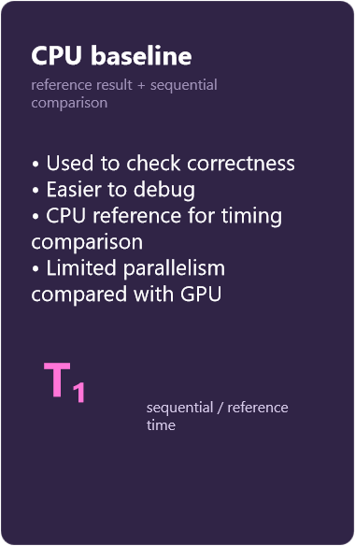
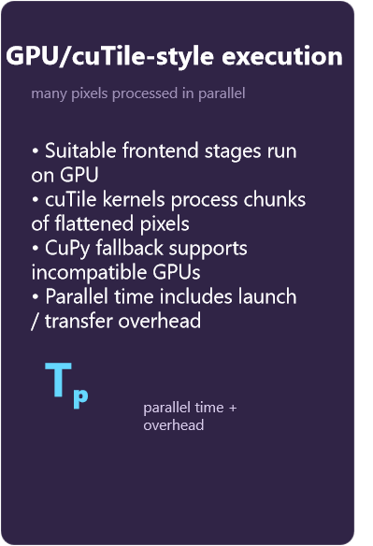
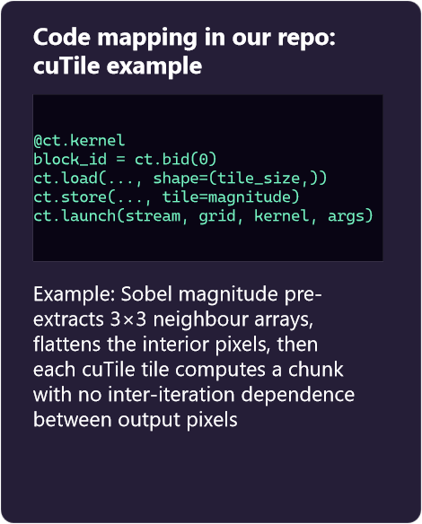
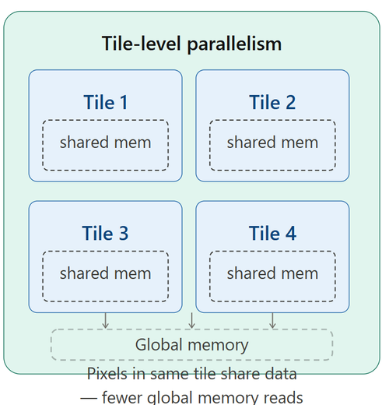
Why GPU / cuTile-style Kernels?
Grace Liu
Notes:
Based on the dependency analysis, the suitable frontend stages can be mapped to GPU execution.
The CPU baseline is still important because it gives us a correctness reference and a timing baseline.
The reason we use GPU is that many output pixels can be computed independently. This is the pixel-level data parallelism we discussed earlier.
cuTile is one way to express this parallelism on NVIDIA GPUs. The benefit is that it gives us a higher-level tile abstraction, so we can describe computation over chunks of pixels instead of manually managing every low-level CUDA thread.
In our code, this becomes a hybrid design. Suitable frontend stages run on GPU, cuTile-style kernels are used where supported, and CuPy fallback is used when needed.
Thresholding and hysteresis remain as CPU post-processing.
The code example shows the Sobel cuTile idea: the image interior is flattened into chunks, and each tile computes independent output pixels.
Next, Xudong will explain the implementation in more detail.

Slide 7



Implementation
Xudong Ma
⚠ cuTile requires Ampere/Ada/Blackwell GPU (sm_80+). GTX 1050 Ti (Pascal, sm_61) uses CuPy fallback
Three implementations corresponding to different parallel models
CPU Baseline
CuPy GPU
cuTile GPU
Pure NumPy/Python
GPU-accelerated
Tile-based (Ampere+)
scipy.ndimage Gaussian
NumPy Sobel gradients
Python NMS loop
CV2 hysteresis
Reference for correctness
cp.convolve Gaussian
CuPy Sobel arrays
CuPy NMS (vectorised)
CPU post-processing
10.64× faster blur
Tile-based Gaussian
cuTile Sobel kernel
cuTile NMS kernel
Full GPU pipeline
Requires sm_80+
Sequential / SISD model
Data Parallelism on GPU
Tile-Parallel + CuPy fallback
Notes:
Thank you, Grace. Grace has explained why we need to move from CPU to GPU and eventually to cuTile. Now let me walk you through our Implementation work.
We implemented three progressively optimized versions, each corresponding to a different parallel model.
On the left is the CPU Baseline. We implemented the standard Canny pipeline using pure NumPy and SciPy, in the file canny_pipeline.py. This version is clear and easy to debug. It serves as our correctness reference and timing baseline. It is a fully Sequential / SISD model.
In the middle is the CuPy GPU version. We migrated all array operations to the GPU with almost zero code changes, in the file sobel_gpu_baseline.py. This achieved Data Parallelism on GPU. For example, Gaussian Blur reached a 10.64× compute-only speedup.
On the right is our main contribution — the cuTile GPU version, in cutile_full_pipeline.py. We implemented dedicated cuTile kernels for Gaussian and Sobel Magnitude. NMS also runs on GPU using CuPy — we explored a cuTile NMS design, but NMS requires gradient angle information across neighbouring pixels, which involves inter-tile data sharing that cuTile's 1D tile model doesn't natively support. Using pre-extracted neighbour arrays and tile-parallel design, we achieved true Tile-Parallel execution.
Now let me show you the actual kernel code behind this design.

Slide 8
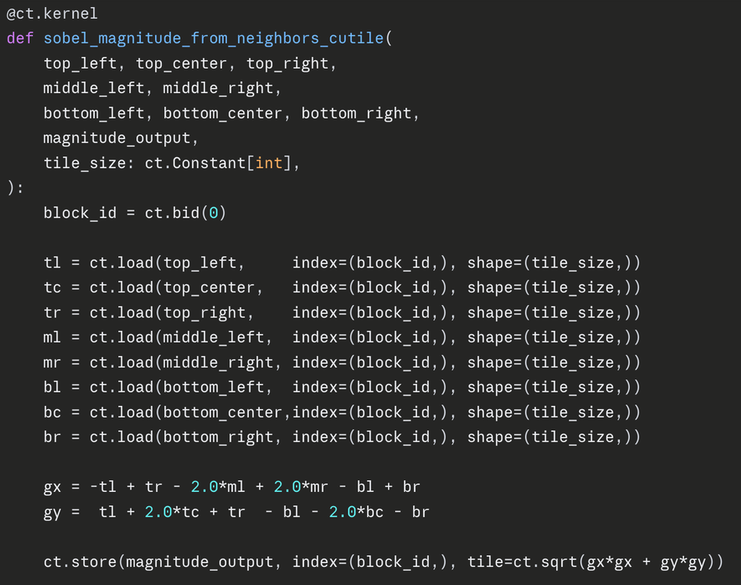
Xudong Ma
cuTile Kernel Design — Sobel Magnitude
Pre-extracted neighbours 8 shifted arrays passed in — zero inter-tile dependency
Tile-level operations ct.load / ct.store process tile_size pixels per block
No manual thread management cuTile handles parallel dispatch — simpler than raw CUDA
Notes:
"This is the actual Sobel cuTile kernel from sobel_cutile_benchmark.py.
The key design decision: instead of passing the full image, we pre-extract 8 neighbour arrays outside the kernel. So each tile loads only its own chunk, computes Gx and Gy independently, and stores the magnitude — zero inter-tile dependencies, full parallelism.
ct.load and ct.store handle tile-level memory automatically. No manual thread indexing, no shared memory management — that's the advantage of cuTile over raw CUDA.
Now let me walk through the scheduling decisions we built on top of this."
"Now let me show you the actual cuTile kernel we wrote — this is the core of our GPU implementation.
This is the Sobel magnitude kernel from sobel_cutile_benchmark.py. The key design decision is visible right here: instead of passing the full image into the kernel, we pre-extract 8 shifted neighbour arrays outside — top-left, top-center, all the way to bottom-right. This means each tile loads only its own chunk of pixels, computes Gx and Gy independently, and stores the magnitude. There are zero dependencies between tiles, which is exactly what makes full parallelism possible.
ct.load and ct.store are cuTile's tile-level memory operations — each block processes exactly tile_size pixels in one shot. And compared to raw CUDA, we never manually manage thread indices or shared memory. cuTile abstracts all of that away, which is the whole point of using it as a higher-level programming model.
This kernel is the foundation of everything I'll discuss next in our scheduling decisions."

Slide 9
Xudong Ma
Scheduling & Optimisation Decisions
Tile Size Sweep
Memory Transfer Minimisation
Tested tile sizes 64/128/256/512. Tile size = 64 gave the best performance — the only tunable parameter for parallel granularity. Larger tiles increase register pressure → lower occupancy → worse throughput.
Input transferred once; all intermediate results stay on GPU. Only NMS output copied back to CPU for post-processing. Minimised communication cost.
PARAMETER
MEMORY
GPU Frontend, CPU Postprocess
Percentile-Based Thresholds
Gaussian, Sobel, and NMS run on GPU. Double threshold and hysteresis use CPU (cv2) — fast enough at <5ms per frame. Hybrid scheduling design.
Adaptive thresholds (high = 90th percentile of NMS values) avoid frame-to-frame flicker. More robust for video streams.
DESIGN
ALGORITHM
From dependence analysis → scheduling decisions → balanced performance & compatibility
Notes:
“In the Scheduling & Optimisation Decisions section, we made four key optimisation choices.
First is the Tile Size Sweep. We systematically tested tile sizes of 64, 128, 256, and 512 — tile size is the only tunable parameter for parallel
granularity个 ruang 牛来弱体
in cuTile. Larger tiles increase register pressure per thread block, leading to lower SM occupancy and worse overall throughput. I'll go into the data in detail on the next slide.
Second is Memory Transfer Minimisation. We transfer the input image to the GPU only once, keep all intermediate results on the GPU, and only copy the NMS output back to the CPU for post-processing. This directly minimises the PCIe communication cost
— one of the key scheduling challenges from the course.
Third is our GPU Frontend + CPU Postprocess hybrid design. Gaussian, Sobel, and NMS run on the GPU. Double Threshold and Hysteresis 黑斯特瑞 sis
are executed on the CPU using cv2. The reason Hysteresis stays on CPU is not just that it's fast enough — it's that Hysteresis has a graph-traversal dependence. Whether a weak edge survives depends on whether it connects to a strong edge, which requires global BFS propagation破扰波给神 across the entire image. This is a flow dependence identified in our dependence analysis, and cuTile has no mechanism for inter-tile communication of this kind. So keeping it on CPU is the correct architectural decision, not just a convenience.
Finally, Percentile-Based Thresholds. For video streams, we adopted adaptive thresholds based on the 90th percentile of NMS values. This avoids frame-to-frame flicker and is far more robust than fixed thresholds for real-time use.
These four decisions together gave us a good balance between performance, compatibility, and correctness. Now let me show you the tile size data in detail.

Slide 10
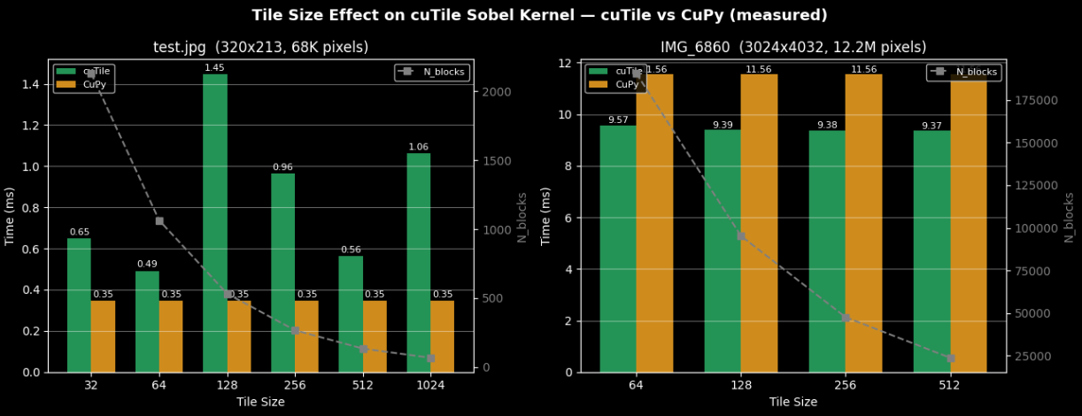
Xudong Ma
Tile Size: The Only Tunable Parameter
Small Scale: Tile=64 offers the best balance between SM utilization and kernel launch overhead.
Large Scale: Stable performance with abundant N_blocks and low sensitivity to tile size.
Conclusion: No one-size-fits-all — per-dimension testing is required.
Notes:
In cuTile, tile size directly determines how many pixels each block processes, which controls both SM utilisation and kernel launch overhead. We tested tile sizes from 32 to 1024 and compared cuTile against CuPy directly.
From the left chart ， tile = 64 gives the best performance. Too small a tile means too many kernel launches and dominant launch overhead. Too large a tile means too few blocks, leaving many SMs idle while also increasing register pressure per block.
The right chart tells a different story. With a large image, there are enough pixels to keep all SMs busy regardless of tile size, so performance is stable across 128, 256, and 512. The sensitivity to tile size essentially disappears.
The key conclusion is: there is no one-size-fits-all tile size. For small images, tile = 64 achieves the best balance. For large images, tile size matters much less. Per-dimension testing is required.

Slide 11
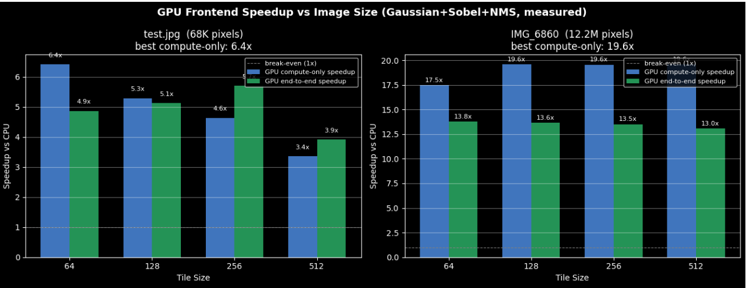
Larger Images → Higher GPU Utilization → Better Speedup
Xudong Ma
Compute-only: GPU kernel time vs. CPU execution time (excluding data transfer) End-to-end: Full pipeline latency, including PCIe transfer overhead
Notes:
Finally, the data confirms a clear pattern: larger images give the GPU more parallel work, so speedup scales up dramatically — from around 6× on the small image to nearly 20× on the large one. This is exactly what Gustafson's Law from Lecture 02 predicts. I'll hand over to Shiying for the full pipeline results."
Finally, let's look at how image size affects overall GPU parallel efficiency.
The left chart is the small image at 68K pixels, and the right is the large image at 12.2 million pixels. The GPU frontend speedup — covering Gaussian, Sobel, and NMS — increases dramatically with image size.
To be clear on the two measurements: compute-only measures pure kernel execution time, while end-to-end includes PCIe data transfer overhead. With the large image, GPU SM utilisation is much higher, and we reach speedups close to 20× compute-only — far above what the small image achieves.
This directly confirms what Amdahl's Law and Gustafson's Law both suggest from Lecture 02: with more parallel work available, the sequential and overhead fractions shrink proportionally, and the GPU's parallel advantage scales up. The more pixels we give the GPU, the better it performs.

Slide 12
Benchmark Result
Shiying Yang
Stage level vs End -to-End Speed up
tile_size | Compute-only speedup | End-to-end speedup | CPU total
64 | 17.5× | 13.8× | 1174 ms
128 | 19.6× | 13.6× | 729ms
256 | 19.6× | 13.5× | 729ms
512 | 19.6× | 13.0× | 729ms
Notes:
Let's look at the measured benchmark numbers.
We break the results into two levels. The first is the GPU frontend in isolation — Gaussian, Sobel, and NMS combined. Compute-only speedup, which measures just the GPU kernel time against CPU with no transfer included, peaks at 19.6× at tile sizes 128 and 256. Adding PCIe transfer brings end-to-end speedup down to around 13.5×, showing transfer has some cost, but the GPU frontend itself is genuinely fast.
The second level is the full pipeline speedup — GPU frontend plus CPU Hysteresis together, compared against a pure CPU baseline for the complete Canny pipeline. That number is 2.32×.
19.6× versus 2.32× — this gap is the central question of the entire performance analysis. The GPU frontend achieves nearly 20× speedup in isolation, so why does the full pipeline only reach 2.32×? The next slide answers that.

Slide 13





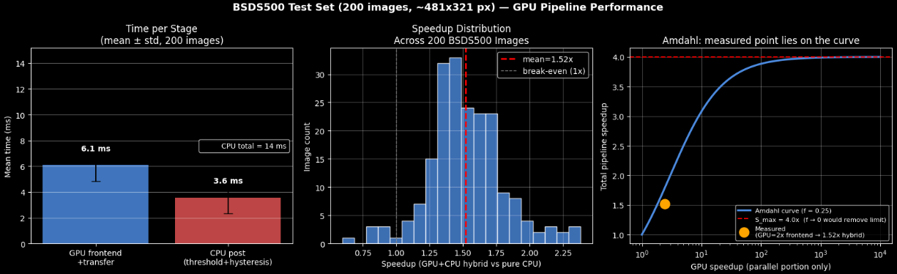
Reason: Amdahl’s law
Shiying Yang
= Hysteresis Time / Full CPU Execution
Time (Serial Fraction)
= GPU Frontend Speedup (Parallel Portion Speedup)
S（max） = 1/ , when
test.jpg: CPU total=177ms,
GPU frontend=3.4ms
CPU post=157ms
f=0.88 S_max=1.1x
As long as Hysteresis runs on CPU, the ceiling is locked at 1/f — regardless of how fast the GPU frontend becomes.
Notes:
The answer is Amdahl's Law.
The formula is straightforward: total speedup S equals one divided by the serial fraction f plus the contribution of the parallel portion. As the parallel part approaches infinite speed, the ceiling converges to 1/f.
In our pipeline, f comes from Stage 5 — Hysteresis. It currently has to run on CPU because connected-component analysis involves chain-like data dependencies with no fixed computation range, making it incompatible with cuTile's tile model. This is a structural constraint of the algorithm, not a limitation of our implementation.
Look at the chart on the left. Each bar has two segments: blue for GPU frontend plus PCIe transfer, red for CPU Hysteresis. The red portion is substantial — that's f made visible.
We computed f from measured data, derived S_max from the formula, and plotted the measured hybrid speedup onto the Amdahl curve. The orange dot lands directly on the curve — theory and experiment agree.
The conclusion: no matter how fast the GPU frontend becomes, as long as Hysteresis runs on CPU, the overall speedup is capped at 1/f. This is Amdahl's Law working exactly as expected.
One additional note — we repeated this analysis across 200 images from the BSDS500 benchmark dataset, and the measured mean point lands on the same curve. The conclusion holds generally, not just for a specific image.

Slide 14
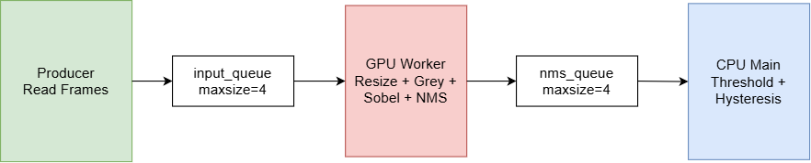
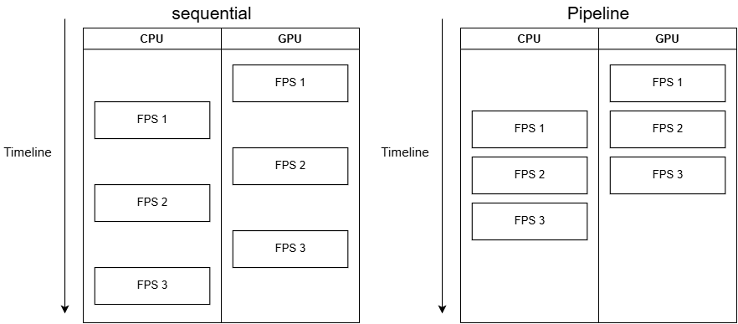
Video Stream: pipeline Parallelism across Frames
Shiying Yang
architecture
pattern | test | Whether real-time ≥30fps has been achieved | Throughput FPS
Sequential | 30 frames of image-loop | NO | 9.36
Pipeline | 30 frames of image-loop | YES | 39.57
Pipeline | 100 frames per second camera | NO | 22.79
Timeline comparison
Throughput FPS ≠ per-frame latency. Pipeline improves system throughput, not single-frame end-to-end delay.
Notes:
As we transitioned the algorithm to video streams, we had a new idea: video capture is essentially a continuous sequence of image frames. So can we process multiple image at the same time？
The benchmark we discussed measures single-frame sequential processing. Here we introduce a different dimension: task parallelism across frames.
The implementation uses three threads. A Producer thread reads frames — in image-loop mode it cycles through test.jpg, in camera mode it reads from a real webcam. A GPU Worker thread handles Stages 1 through 3. The main thread runs CPU post-processing for Stages 4 and 5. Two queues connect the three, both with maxsize=4 to provide backpressure and prevent memory overflow.
Frames are resized to width 512 before entering the pipeline. Frame 0 is excluded as a CUDA JIT warm-up; statistics are collected from frame 1 onward. Both modes ran for 100 frames.
Results: image-loop sequential gives 9.36 FPS, pipeline gives 39.57 FPS; camera pipeline gives 22.79 FPS.
Image-loop is faster because test.jpg is already in memory — the Producer reads frames with almost no I/O delay, so the GPU runs continuously at full capacity. The camera introduces real hardware latency constrained by USB bandwidth and driver overhead.
One final point: 39.57 FPS is throughput, not per-frame latency.
Pipeline parallelism increases how many frames the system completes per second, but does not reduce the end-to-end delay for any individual frame.

Slide 15
Shiying Yang
Future Work
Challenge
Future work
Hysteresis parallelization Connected-component analysis has chain-like dependencies with no fixed computation range, making it incompatible with cuTile's tile model — the root cause of our Amdahl ceiling.
Low GPU efficiency on small images PCIe transfer and kernel launch overhead dominate at small image sizes, pushing end-to-end speedup close to or below 1×.
Camera I/O bottleneck Hardware latency from the physical camera limits pipeline throughput — an external constraint, not an algorithmic one, but it prevents reaching the real-time target.
GPU Connected Components (highest priority) Algorithms such as ECL-CC enable parallel connected-component analysis on GPU, reducing f from 0.5–0.8 to near zero and raising the theoretical end-to-end speedup to 10–20×.
Pinned Memory + CUDA Streams Pinned memory eliminates the extra copy step during data transfer; CUDA Streams allow transfer and computation to overlap, reducing end-to-end latency.
Notes:
First, Hysteresis parallelization. The chain-like data dependencies in connected-component analysis fall outside the scope of cuTile's tile model. However, this is a solvable problem — GPU Connected Components algorithms such as ECL-CC can perform parallel connected-component analysis directly on the GPU, reducing the serial fraction f to near zero.
Second, low GPU efficiency on small images — PCIe transfer and kernel launch overhead dominate at small image sizes, pushing end-to-end speedup close to or even below 1 times.
Third, camera I/O bottleneck — hardware latency from the physical camera limits throughput in real deployment, independent of the algorithm itself.
About the future direction, first is Pinned Memory combined with CUDA Streams — eliminating the transfer copy overhead and overlapping data transfer with computation to reduce end-to-end latency.
The second direction is validating scalability at higher resolutions. Our current benchmarks are primarily at standard dataset resolutions. At 1080p and above, pixel count increases substantially, GPU utilization improves, and speedup is expected to climb further.

Slide 16
Thank You
Q&A
Notes:
1.
No, I do not think the frontend optimisation targeted the wrong part.
From our dependency analysis, Gaussian, Sobel and NMS are the stages that naturally fit GPU data parallelism, so they are the right first targets for cuTile-style optimisation.
But the result shows the limitation: frontend optimisation only improves the parallel part. The full pipeline is still limited by the serial CPU part, especially hysteresis. So the frontend optimisation was useful, but it also revealed that the next bottleneck is CPU post-processing.
2.
We'd time each part separately — GPU frontend, PCIe transfer, thresholding, and hysteresis. Then swap each one out with a near-zero placeholder and see how much the overall speedup improves. The part that gives the biggest gain when removed is the real bottleneck. Our Amdahl analysis already points to hysteresis, but this would confirm whether transfer is actually the bigger issue.
Why do you use a 5×5 Gaussian kernel? What does sigma=1.4 control?
The 5×5 kernel covers roughly 3 sigma. Sigma=1.4 controls the blur strength — higher values suppress more noise but lose fine detail. 1.4 is the classic trade-off from the original Canny paper.
How do you choose the thresholds for double thresholding?"
"双阈值怎么确定的？"
We use adaptive percentile thresholds — the 90th percentile of non-zero NMS values as the high threshold, with the low threshold set at half that. This keeps thresholds relative to each image's own magnitude distribution rather than relying on fixed values.
What is cuTile and how is it different from writing CUDA directly?

